Slide 1

Class comparisons association rule mining: Market basket analysis- basic concepts.
Submitted by:
Jay kakdiya: 160410116046
Kaushiki kansara: 160410116048
Devangini kathad : 160410116049
Kaustubh wade : 160410116050

Slide 2
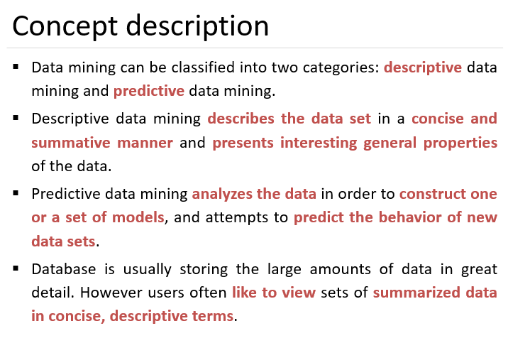

Slide 3
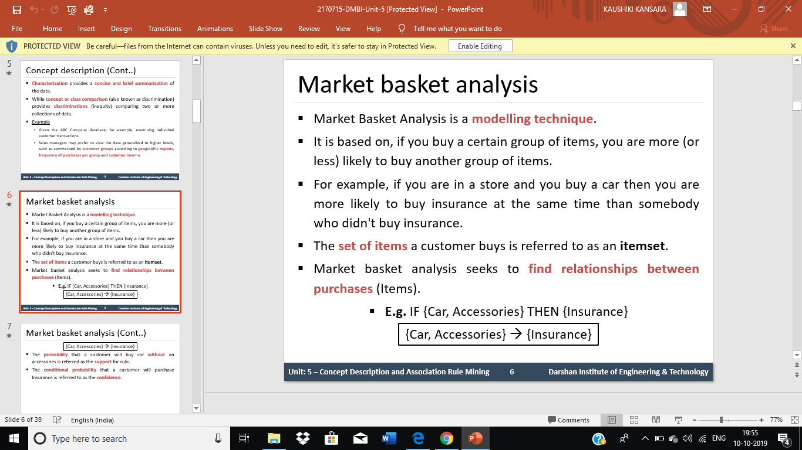

Slide 4
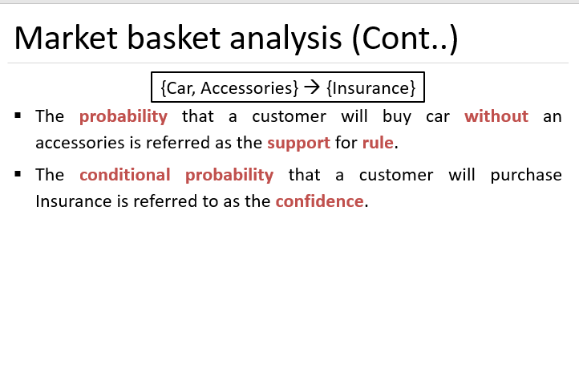

Slide 5
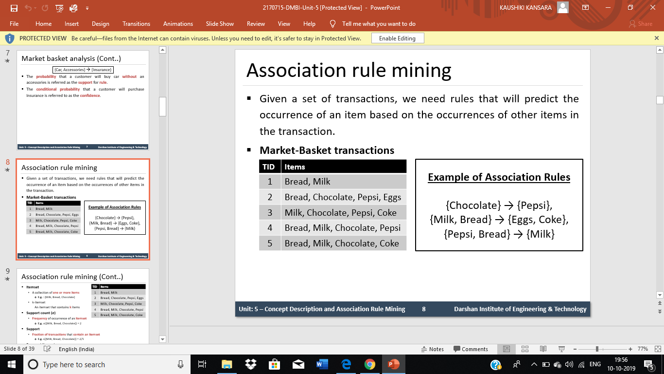

Slide 6
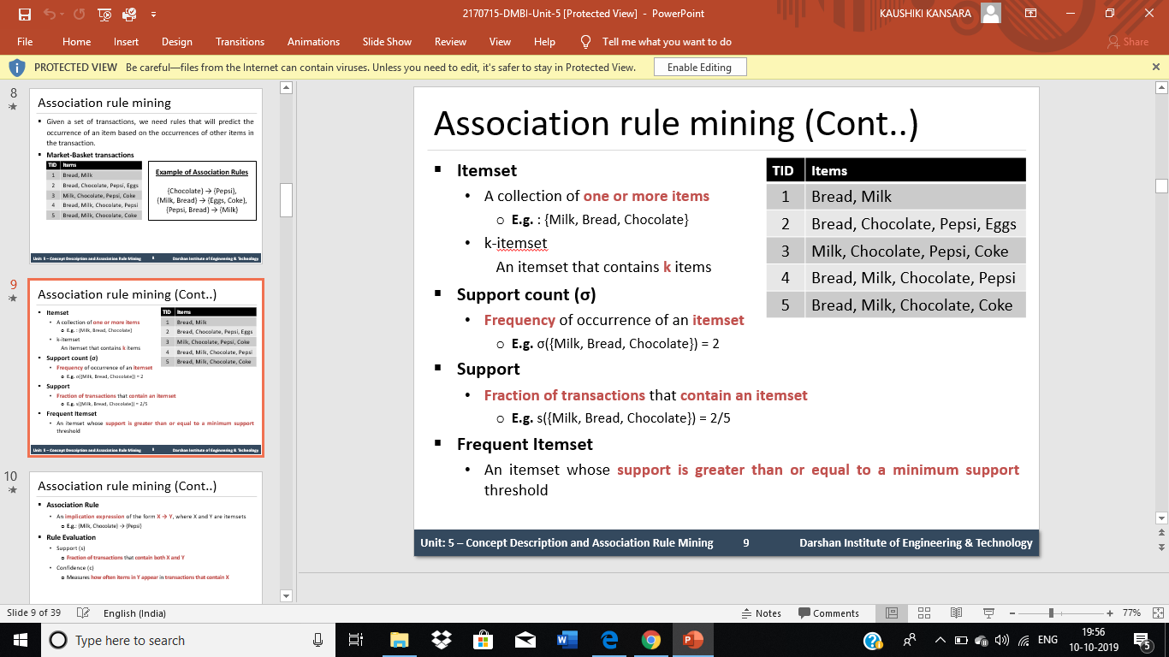

Slide 7
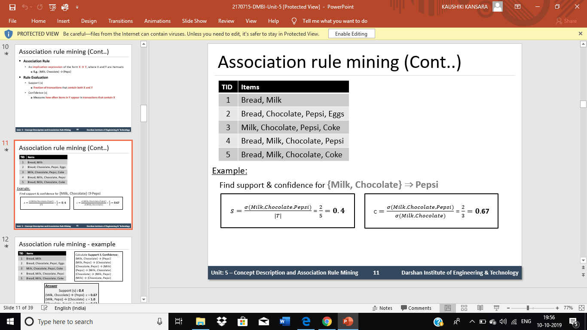

Slide 8
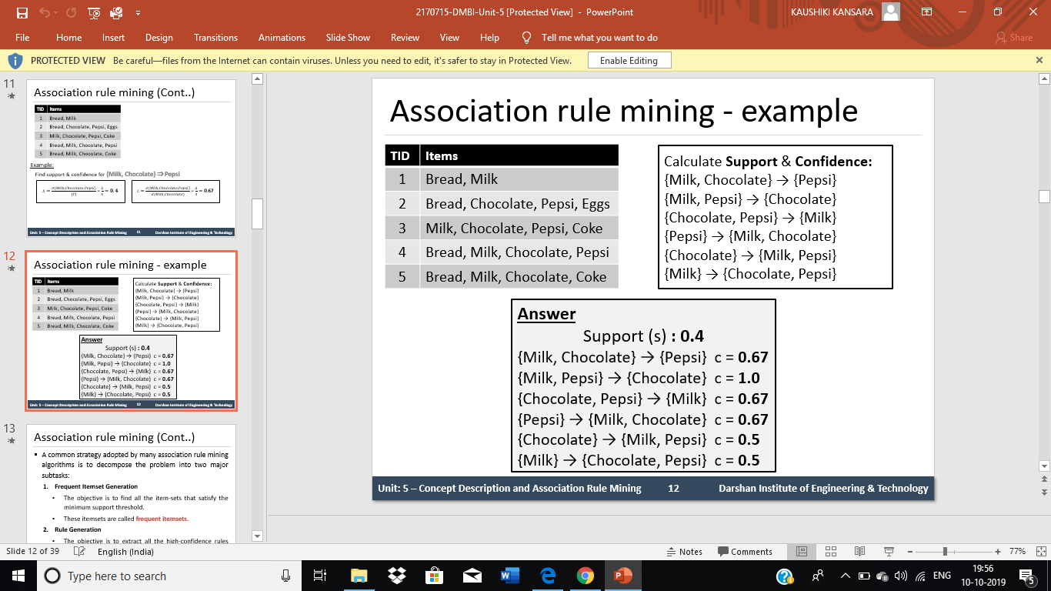

Slide 9
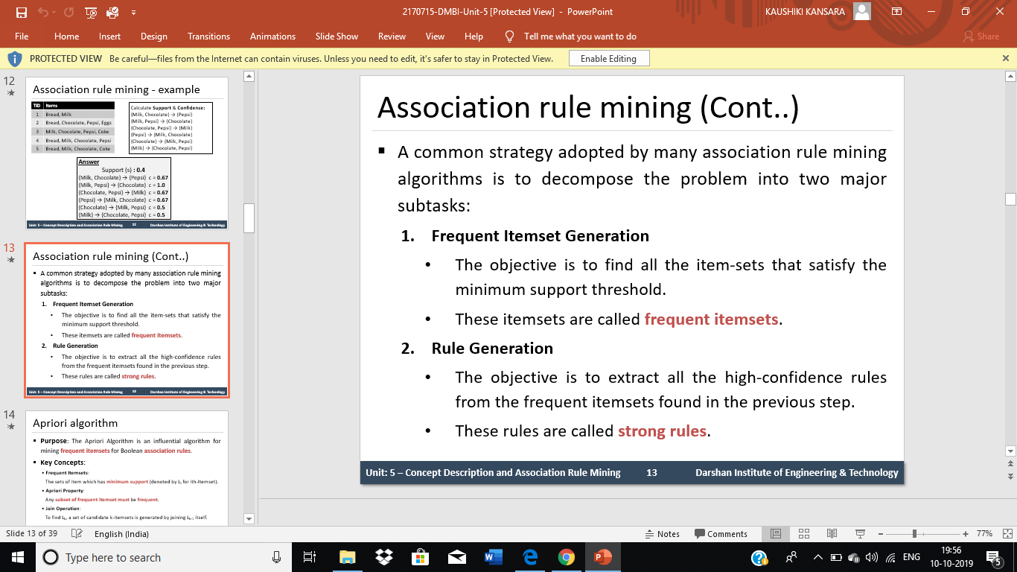

Slide 10
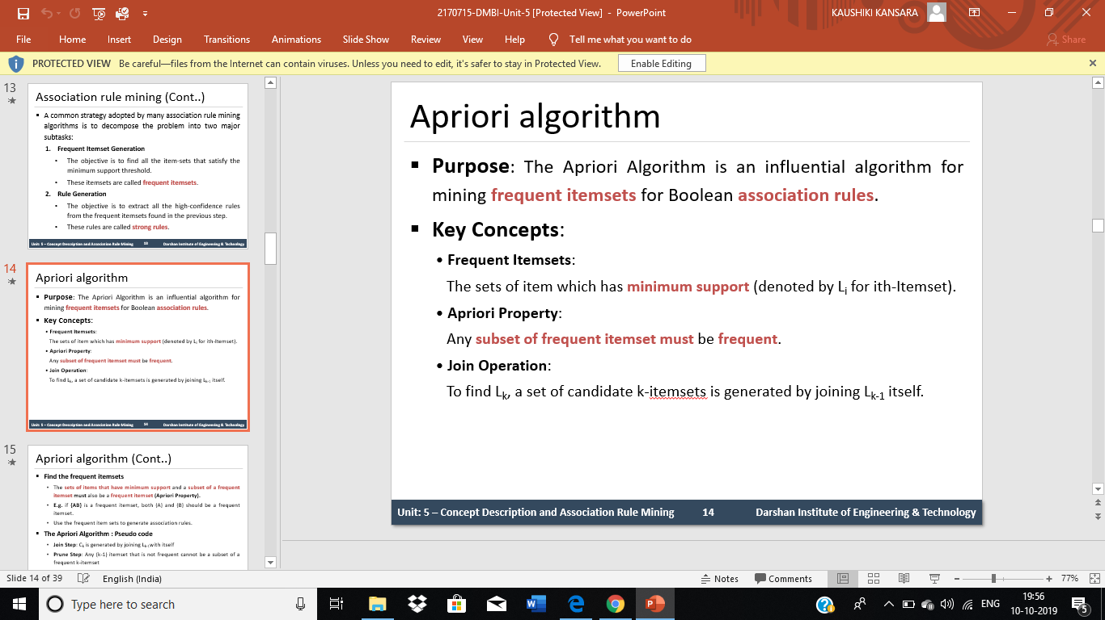

Slide 11
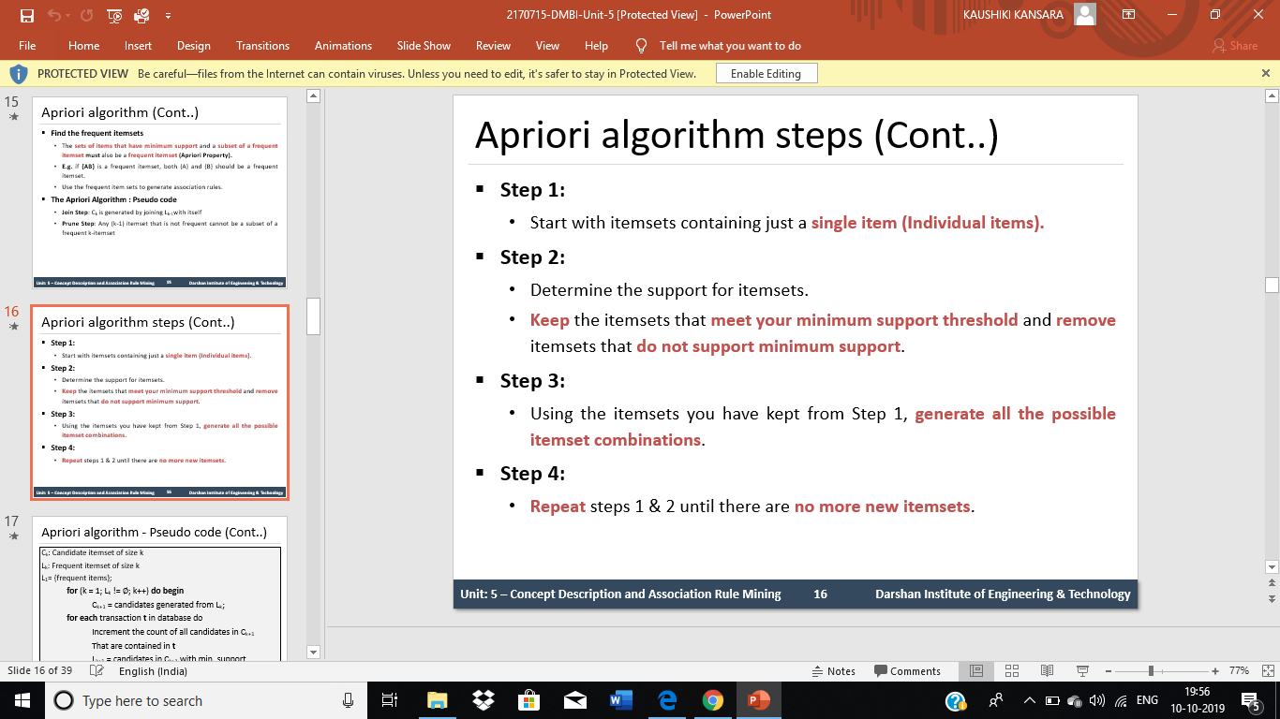

Slide 12
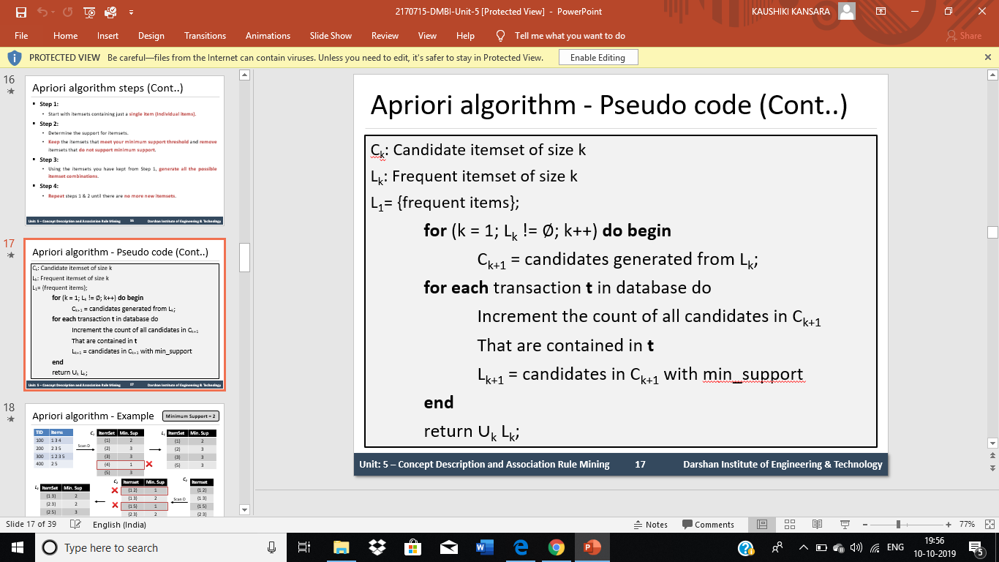

Slide 13
THANK YOU

